Slide 1

Smart Pointers

Slide 2

Problems with normal pointers
Memory leaks: Memory is allocated but not freed, causing excessive usage and system crashes.
Hanging pointers: Pointers still point to released memory, leading to undefined behavior.
Wild pointers: Uninitialized pointers point to invalid memory addresses.
Data inconsistency: Data stored in memory is not updated consistently.
Buffer overflow: Writing outside allocated memory corrupts data and poses security risks.

Slide 3
What are Smart Pointers?
Smart pointers in C++ are special objects that act like regular pointers but provide additional features, such as automatic memory management.
They help prevent common issues like memory leaks and dangling pointers

Slide 4
What are they? Smart pointers are classes in the C++ Standard Library that wrap around raw pointers and manage their memory automatically.
Why use them? They eliminate the need to manually delete memory, which helps avoid memory leaks and other pointer-related problems
Types of Smart Pointers:
std::unique_ptr
std::shared_ptr
std::weak_ptr

Slide 5
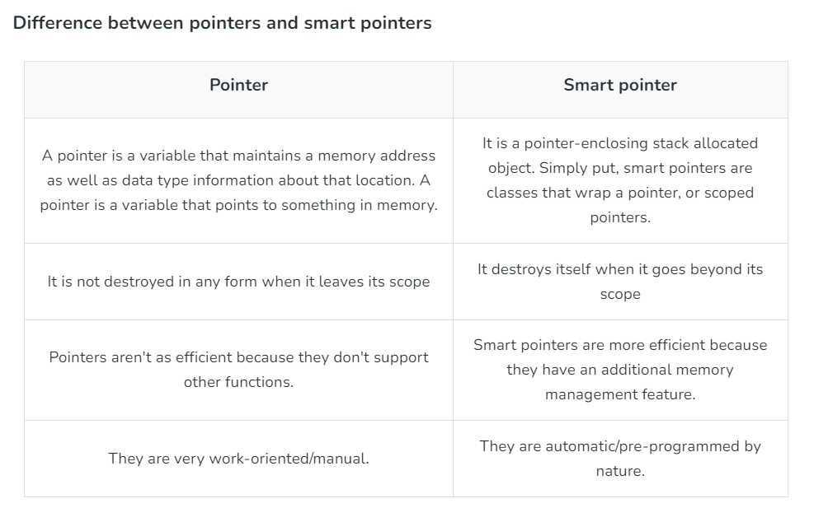

Slide 6
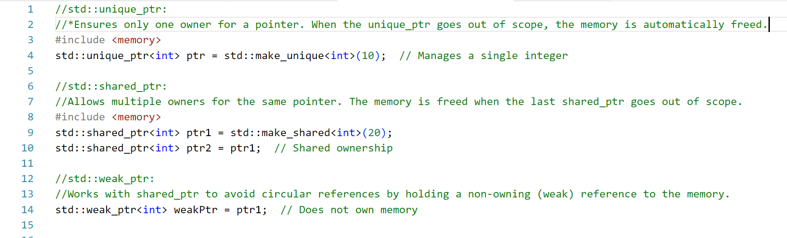

Slide 7
IDE

